Slide 1
Remote Procedure Call (RPC)
Lecture-10

Slide 2
Remote Procedure Call (RPC)
A Remote Procedure Call (RPC) is a software communication protocol that one program uses to request a service from another program located on a different computer and network, without having to understand the network's details.
Specifically, RPC is used to call other processes on remote systems as if the process were on a local system.
When a process on machine A calls a procedure machine B, the calling process on A is suspended, and execution of the called procedure takes place on B.
Information can be transported from the caller to the callee in the parameters and can come back in the procedure result.

Slide 3
Cont..
Basic RPC operation:
Consider a single machine conventional procedure call:
count = read(fd, buf, nbytes);
Where, fd is an integer, buf is an array of characters, and nbytes is another integer.
If the call is made from the main function, the stack will be as shown in Fig. 2-17(a) (next slide) before the call.
To make the call, the caller pushes the parameters onto the stack (Fig. 2-17(b)).
After read has finished running, it puts the return value in a register, removes the return address, and transfers control back to the caller.
The caller then removes the parameters from the stack, returning it to the original state (Fig. 2-17(c)).

Slide 4
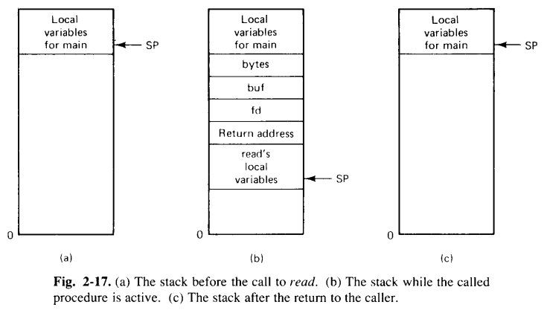
Cont..

Slide 5
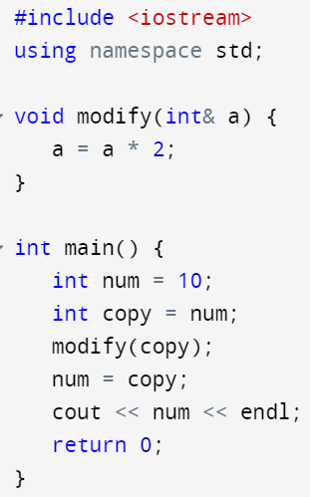
Cont..
Parameters passing mechanism in procedure call:
1. Call by value:
2. Call by reference:
3. Call by copy/restore (Not available in C programming): In this method the variables are copied to the stack by the caller (as in call by value), and then copied back after the call, overwriting the caller’s original value.
Example:
OUTPUT:
20

Slide 6
Cont..
The idea behind RPC is to make a remote procedure call look as much as possible like a local one.
In other words - we want RPC to be transparent - the calling procedure should not be aware that the called procedure is executing on a different machine.
Suppose read is a remote procedure (e.g, one that will run on the file server’s machine), a different version of read, called a client stub, is put into the library.
Like the original one, it too, is called using the calling sequence of Fig. 2-17. Also, it too, traps to the kernel.
Only unlike the original one, it does not put the parameters in registers and ask the kernel to give it data.
Instead, it packs the parameters into a message and ask the kernel to send the message to the server, as shown by Fig. 2-18 (next slide).
Following the call to send, the client stub calls receive, blocking itself until the reply comes back.

Slide 7
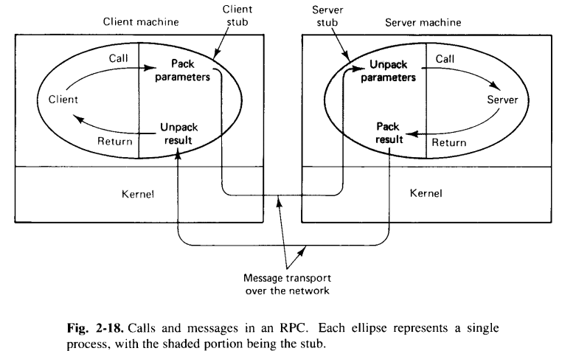
Cont..

Slide 8
Cont..
When the message arrives at the server, the kernel passes it to a server stub that is bound with the actual server.
The server stub will have called receive and be blocked waiting for incoming messages.
The server stub unpacks the parameters from the message and then calls the server procedure.
The server performs its work and then return the results to the caller.
When the message gets back to the client machine, the kernel sees that it is addressed to the client process.
The message is copied to the waiting buffer and the client process is unblocked.
The client stub inspect the message, unpacks the results, copies it to its caller, and returns in the usual way.

Slide 9
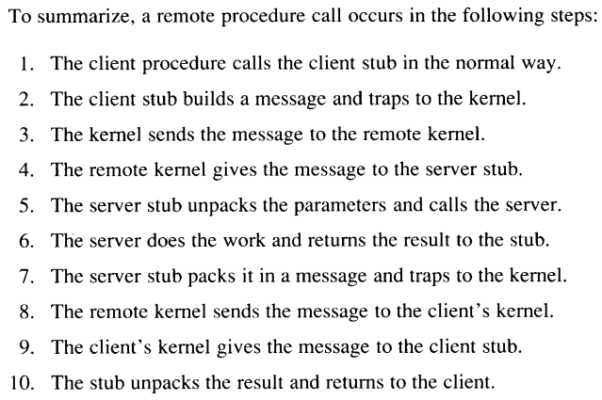
Cont..

Slide 10
Cont..
Parameter Passing:
The function of a client stub is to take its parameters, pack them into a message, and send it to a server stub.
Parameter Marshaling:- Packing the parameters in the message.
The Client Stub takes the parameters and put them in a message.
It also puts the number or name of the procedure to be called in the message. The server machine might support different calls.
Problem occurs when the system at client and server end is different.
Each machine has its own representation for numbers, characters, and other data items.
IBM Mainframe machines :-EBCDIC character code.
IBM personal Computer :- ASCII character code.
Similar problem occurs with representation of integers and floating numbers.

Slide 11
Cont..
Client End:-The compiler reads the server specification and generate a client stub that packs its parameters into the officially approved message format.
Server End:- The compiler can also produce a server stub that unpacks them and calls the server procedure.
The system is trasparent with respect to the differences in the internal representations of the data items.

Slide 12
Cont..
Dynamic Binding:
One method by which client locates to the server is to hardwire the network address of the server into the client.
Problems with this approach are:
Server can move to different location.
Server can be replicated.
Interface can be changed.
To avoid all such problems, an alternative approach, called as dynamic binding can be used.
The client locates server in distributed syetem using Dynamic Binding.
Registering the Server to Binder:-
The server send a message to a program called a binder, to make its existance known.
The server specifies its name, version number, a unique identifier (32 bit long), and a handle used to locate it.

Slide 13
Cont..
The handle is system dependent (Ehternet Address, IP Address and X.500 Address, a sparse process identifier).
It can deregister with the binder when it is no longer prepared to offer service.
The client stub send message to the binder asking it to import version of the server interface.
The binder checks to see if one or more servers have already exported an interface with the version and name. If no server is found the read call fails.
Otherwise , the binder gives the server’s handle and unique identifier to the client stub.
The client stub uses the handle as the address to send the request message

Slide 14
Cont..
RPC Semantics in the Presence of Failure:
Five different classes of failure that can occur in RPC systems:
The client is unable to locate the server.
The request message from the client to the server is lost.
The reply message from the server to the client is lost.
The server crashes after receiving a request.
The client crashes after sending a request.
Client cannot locate the server:
The server might be down, for example.
Alternatively, suppose that the client is compiled using a particular version of the client stub, and the binary is not used for a considerable period of time.
In the meantime, the server evolves and a new version of the interface is installed and new stubs are generated and put into use.
When the client is finally run, the binder will be unable to match it up with a server and will report failure.

Slide 15
Cont..
Handling Strategies:
Retry Mechanism: Implementing a retry mechanism where the client attempts to reconnect after a certain period.
DNS or Service Discovery: Using a dynamic service discovery mechanism to help clients find the server even if its address changes.
Timeouts: Setting reasonable timeouts for connection attempts to avoid indefinite waiting.
Semantics Impact: The client does not receive a response or acknowledgment, so it may assume failure.
This could lead to retries or user notifications about the service being unavailable.

Slide 16
Cont..
Lost Request Messages:
The second item on the list is dealing with lost request messages.
This is the easiest one to deal with: just have the kernel start a timer when sending the request.
If the timer expires before a reply or acknowledgement comes back, the kernel sends the message again.
If the message was truly lost, the server will not be able to tell the difference between the retransmission and the original, and everything will work fine.
Of course, so many request messages are lost that the kernel gives up and falsely concludes that the server is down, in which case we are back to "Cannot locate server."

Slide 17
Cont..
Lost Reply Messages:
Lost replies are considerably more difficult to deal with. The obvious solution is just to rely on the timer again. If no reply is forthcoming within a reasonable period, just send the request once more.
The trouble with this solution is that the client's kernel is not really sure why there was no answer. Did the request or reply get lost, or is the server merely slow? It may make a difference.
In particular, some operations can safely be repeated as often as necessary with no damage being done. A request such as asking for the first 1024 bytes of a file has no side effects and can be executed as often as necessary without any harm being done. A request that has this property is said to be idempotent.
Now consider a request to a banking server asking to transfer a million dollars from one account to another. If the request arrives and is carried out, but the reply is lost, the client will not know this and will retransmit the message. The bank server will interpret this request as a new one, and will carry it out too. Two million dollars will be transferred. Heaven forbid that the reply is lost 10 times. Transferring money is not idempotent.

Slide 18
Cont..
One way of solving this problem is to try to structure all requests in an idempotent way. In practice, however, many requests (e.g., transferring money) are inherently nonidempotent, so something else is needed.
Another method is to have the client's kernel assign each request a sequence number. By having each server's kernel keep track of the most recently received sequence number from each client's kernel that is using it, the server's kernel can tell the difference between an original request and a retransmission and can refuse to carry out any request a second time.
An additional safeguard is to have a bit in the message header that is used to distinguish initial requests from retransmissions (the idea being that it is always safe to perform an original request; retransmissions may require more care).

Slide 19
Cont..
Server Crashes:
The next failure on the list is a server crash. It too relates to idempotency, but unfortunately it cannot be solved using sequence numbers.
Fig. 2-24(a)- A request arrives, is carried out, and a reply is sent.
Now consider Fig. 2-24(b). A request arrives and is carried out, just as before, but the server crashes before it can send the reply.
Finally, look at Fig. 2-24(c). Again a request arrives, but this time the server crashes before it can even be carried out.
The annoying part of Fig. 2-24 is that the correct treatment differs for (b) and (c).
In (b) the system has to report failure back to the client (e.g., raise an exception), whereas in (c) it can just retransmit the request.
The problem is that the client's kernel cannot tell which is which. All it knows is that its timer has expired.

Slide 20
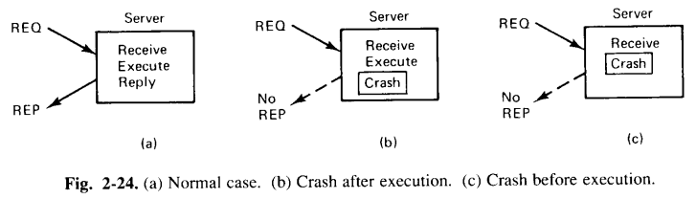
Cont..

Slide 21
Cont..
Three schools of thought exist on what to do here:
One philosophy is to wait until the server reboots (or rebinds to a new server) and try the operation again. The idea is to keep trying until a reply has been received, then give it to the client. This technique is called at least once semantics and guarantees that the RPC has been carried out at least one time, but possibly more.
The second philosophy gives up immediately and reports back failure. This way is called at most once semantics and guarantees that the RPC has been carried out at most one time, but possibly none at all.
The third philosophy is to guarantee nothing. When a server crashes, the client gets no help and no promises. The RPC may have been carried out anywhere from 0 to a large number of times.
The main virtue of this scheme is that it is easy to implement.

Slide 22
Cont..
Client Crashes:
What happens if a client sends a request to a server to do some work and crashes before the server replies?
At this point a computation is active and no parent is waiting for the result. Such an unwanted computation is called an orphan.
Orphans can cause a variety of problems:
As a bare minimum, they waste CPU cycles.
They can also lock files or otherwise tie up valuable resources.
Finally, if the client reboots and does the RPC again, but the reply from the orphan comes back immediately afterward, confusion can result.
What can be done about orphans?
In solution 1, before a client stub sends an RPC message, it makes a log entry telling what it is about to do.
The log is kept on disk or some other medium that survives crashes. After a reboot, the log is checked and the orphan is explicitly killed off. This solution is called extermination.

Slide 23
Cont..
The disadvantage of this scheme is the horrendous expense of writing a disk record for every RPC. Furthermore, it may not even work, since orphans themselves may do RPCs, thus creating grandorphans or further descendants that are impossible to locate. Finally, the network may be partitioned, due to a failed gateway, making it impossible to kill them, even if they can be located.
In Solution 2, called reincarnation, all these problems can be solved without the need to write disk records.
The way it works is to divide time up into sequentially numbered epochs.
When a client reboots, it broadcasts a message to all machines declaring the start of a new epoch.
When such a broadcast comes in, all remote computations are killed.
Of course, if the network is partitioned, some orphans may survive. However, when they report back, their replies will contain an obsolete epoch number, making them easy to detect.

Slide 24
Cont..
Solution 3 is a variant on this idea, but less Draconian. It is called gentle reincarnation.
When an epoch broadcast comes in, each machine checks to see if it has any remote computations, and if so, tries to locate their owner. Only if the owner cannot be found is the computation killed.
Solution 4, expiration, in which each RPC is given a standard amount of time, T, to do the job.
If it cannot finish, it must explicitly ask for another quantum, which is a nuisance.
On the other hand, if after a crash the server waits a time T before rebooting, all orphans are sure to be gone. The problem to be solved here is choosing a reasonable value of T in the face of RPCs with wildly differing requirements.
In practice, none of these methods are desirable. Worse yet, killing an orphan may have unforeseen consequences. For example, suppose that an orphan has obtained locks on one or more files or data base records. If the orphan is suddenly killed, these locks may remain forever. Also, an orphan may have already made entries in various remote queues to start up other processes at some future time, so even killing the orphan may not remove all traces of it.

